Slide 1
Processing Images with OpenCV
Ming Chi University of Techology
Mechanical Engineering Department
Prof. Meng-Jey Youh Ph.D

Slide 2
Table of Contents
Crop an Image
Resize an Image
Adjust Image Contrast
Make an image blurry
Detect Edges
Geometric Transformations of Images
Get image contour

Slide 3
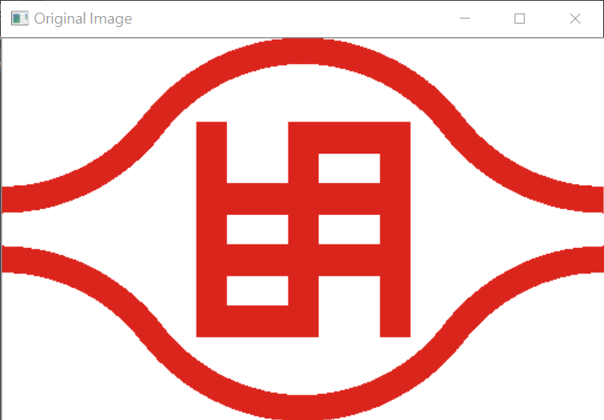
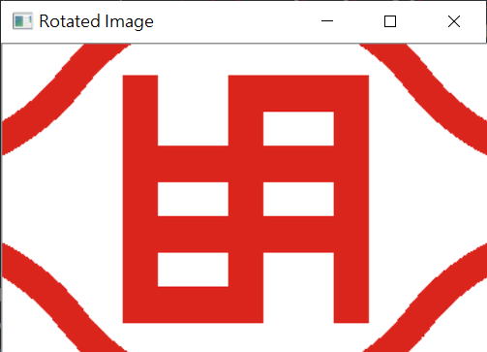
Crop an Image (ex01)
import cv2
img = cv2.imread("mcut.png")
height, width = img.shape[0:2]
startRow = int(height*.15)
startCol = int(width*.15)
endRow = int(height*.85)
endCol = int(width*.85)
croppedImage = img[startRow:endRow, startCol:endCol]
cv2.imshow('Rotated Image', croppedImage)
cv2.waitKey()
cv2.destroyAllWindows()

Slide 4
Resize an Image (ex02)
import cv2
img = cv2.imread("mcut.png")
newImg = cv2.resize(img, (0,0), fx=0.75, fy=0.75)
cv2.imshow('Original Image', img)
cv2.imshow('Resized Image', newImg)
cv2.waitKey()
cv2.destroyAllWindows()

Slide 5
Adjust Image Contrast
The syntax of addWeighted() method
cv2.addWeighted(source_img1, alpha1, source_img2, alpha2, beta)
new_img = a * original_img + b
Here a is alpha which defines contrast of the image. If a is greater than 1, there will be higher contrast.
If the value of a is between 0 and 1 (smaller than 1 but greater than 0), there would be lower contrast. If a is 1, there will be no contrast effect on the image.
b stands for beta. The values of b vary from -127 to +127.
To implement this equation in Python OpenCV, you can use the addWeighted() method. We use The addWeighted() method as it generates the output in the range of 0 and 255 for a 24-bit color image.

Slide 6
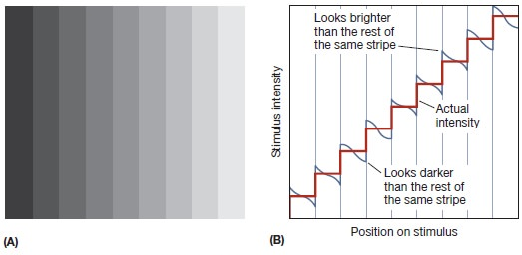
Contrast & Brightness

Slide 7
Adjust Image Contrast (ex03)
import cv2
import numpy as np
img = cv2.imread("mcut.png")
contrast_img = cv2.addWeighted(img, 2.5, np.zeros(img.shape, img.dtype), 0, 0)
#contrast_img = cv2.addWeighted(img, 2, img, 0, -127)
cv2.imshow('Original Image', img)
cv2.imshow('Contrast Image', contrast_img)
cv2.waitKey()
cv2.destroyAllWindows()

Slide 8
Adjust Image Contrast (ex04)
import cv2
import numpy as np
img = cv2.imread("campus.png")
contrast_img = cv2.addWeighted(img, 2.5, np.zeros(img.shape, img.dtype), 0, 0)
#contrast_img = cv2.addWeighted(img, 2, img, 0, -127)
cv2.imshow('Original Image', img)
cv2.imshow('Contrast Image', contrast_img)
cv2.waitKey()
cv2.destroyAllWindows()

Slide 9
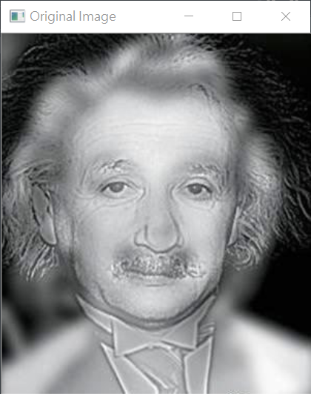
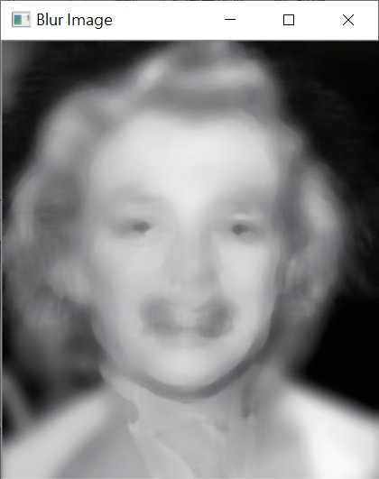
Make an image blurry
Gaussian Blur
Median Blur
Is it Einstein or Marilyn Monroe?

Slide 10
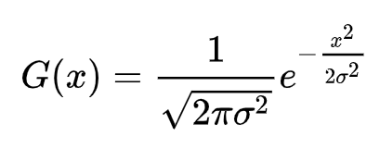
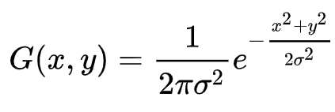
Gaussian Blur
The Gaussian blur is a type of image-blurring filters that uses a Gaussian function (normal distribution) for calculating the transformation to apply to each pixel in the image.
The formula of a Gaussian function in one dimension is
In two dimensions, it is the product of two such Gaussian functions, one in each dimension:
where x is the distance from the origin in the horizontal axis, y is the distance from the origin in the vertical axis, and σ is the standard deviation of the Gaussian distribution.

Slide 11
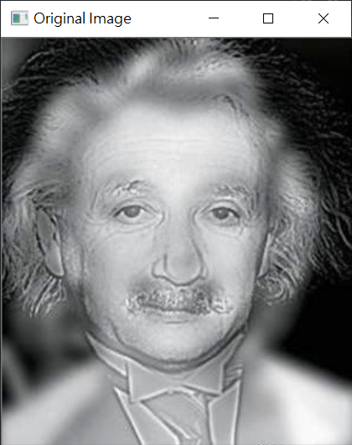

Gaussian Blur (ex05)
import cv2
import numpy as np
img = cv2.imread("blursample.jpg")
blur_image = cv2.GaussianBlur(img, (7,7), 0)
# blur_image = cv2.GaussianBlur(img, (21,21), 0)
cv2.imshow('Original Image', img)
cv2.imshow('Blur Image', blur_image)
cv2.waitKey()
cv2.destroyAllWindows()

Slide 12
Median Blur
The median filter is a non-linear digital filtering technique, often used to remove noise from an image or signal.
Such noise reduction is a typical pre-processing step to improve the results of later processing (for example, edge detection on an image).
Median filtering is very widely used in digital image processing because, under certain conditions, it preserves edges while removing noise (but see the discussion below), also having applications in signal processing.

Slide 13
Worked one-dimensional example
To demonstrate, using a window size of three with one entry immediately preceding and following each entry, a median filter will be applied to the following simple one-dimensional signal:
x = (2, 3, 80, 6, 2, 3).
So, the median filtered output signal y will be:
y1 = med(2, 3, 80) = 3,
y2 = med(3, 80, 6) = med(3, 6, 80) = 6,
y3 = med(80, 6, 2) = med(2, 6, 80) = 6,
y4 = med(6, 2, 3) = med(2, 3, 6) = 3,
i.e. y = (3, 6, 6, 3).

Slide 14
Median Blur (ex06)
import cv2
import numpy as np
img = cv2.imread("blursample.jpg")
blur_image = cv2.medianBlur(img,11)
cv2.imshow('Original Image', img)
cv2.imshow('Blur Image', blur_image)
cv2.waitKey()
cv2.destroyAllWindows()

Slide 15
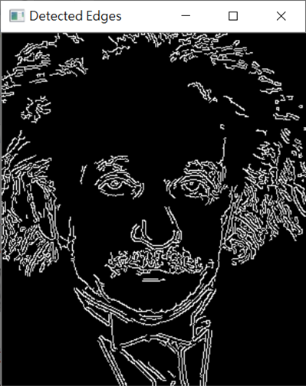
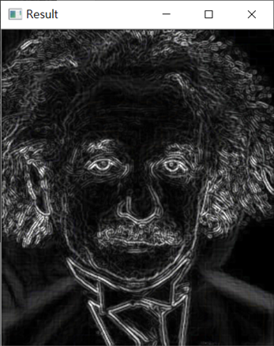
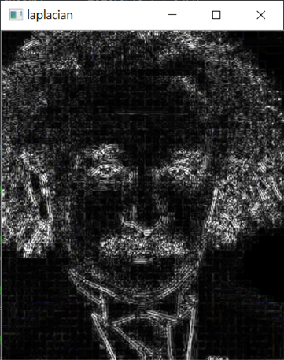
Detect Edges
Canny
Sobel
Laplacian

Slide 16
Canny edge detection
The Canny edge detection algorithm is complex but also quite interesting. It is a five-step process:
Denoise the image with a Gaussian filter.
Calculate the gradients.
Apply non-maximum suppression (NMS) on the edges. Basically, this means that the algorithm selects the best edges from a set of overlapping edges.
Apply a double threshold to all the detected edges to eliminate any false positives.
Analyze all the edges and their connection to each other to keep the real edges and discard the weak ones.

Slide 17
Canny edge detection
To detect the edges in an image, you can use the Canny() method of cv2 which implements the Canny edge detector. The Canny edge detector is also known as the optimal detector.
The syntax to Canny() is as follows:
cv2.Canny(image, minVal, maxVal)

Slide 18


Canny (ex07)
import cv2
import numpy as np
img = cv2.imread("blursample.jpg")
edge_img = cv2.Canny(img,100,200)
cv2.imshow("Detected Edges", edge_img)
cv2.imshow('Original Image', img)
cv2.waitKey()
cv2.destroyAllWindows()

Slide 19
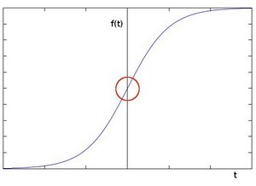
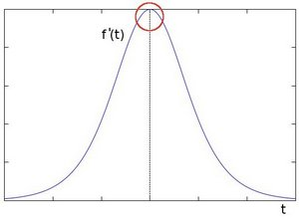
Sobel Derivatives
Edge, the pixel intensity changes in a notorious way.
A good way to express changes is by using derivatives. A high change in gradient indicates a major change in the image.

Slide 20
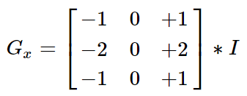
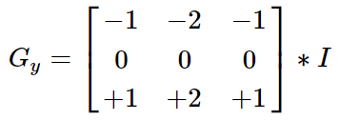
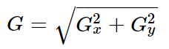
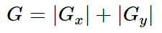
Sobel Derivatives
Assuming that the image to be operated is I :
We calculate two derivatives:
Horizontal changes & Vertical changes : This is computed by convolving I with a kernel Gx & Gy with odd size. For example for a kernel size of 3, Gx & Gy would be computed as:
At each point of the image we calculate an approximation of the gradient in that point by combining both results above:
Although sometimes the following simpler equation is used:

Slide 21

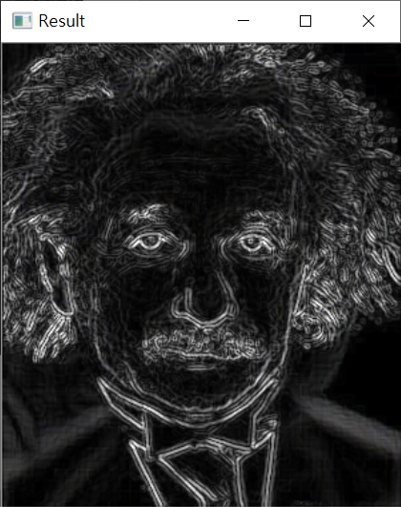
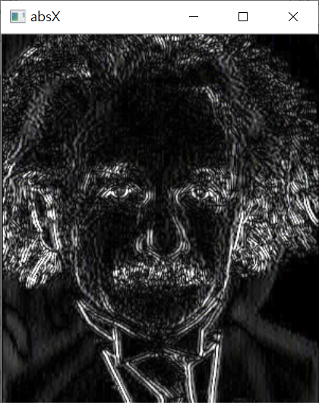
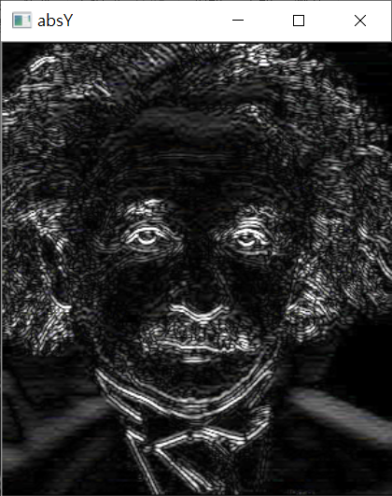
Sobel Derivatives (ex08)
import cv2
import numpy as np
img = cv2.imread("blursample.jpg")
x = cv2.Sobel(img, cv2.CV_16S, 1, 0)
y = cv2.Sobel(img, cv2.CV_16S, 0, 1)
absX = cv2.convertScaleAbs(x)
absY = cv2.convertScaleAbs(y)
dst = cv2.addWeighted(absX, 0.5, absY, 0.5, 0)
cv2.imshow("orign", img)
cv2.imshow("absX", absX)
cv2.imshow("absY", absY)
cv2.imshow("Result", dst)
cv2.waitKey()
cv2.destroyAllWindows()

Slide 22
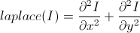
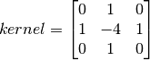
Laplacian Derivatives
It calculates the Laplacian of the image given by the relation,
where each derivative is found using Sobel derivatives.
If ksize = 1, then following kernel is used for filtering:
dst = cv2.Laplacian(src, ddepth[, dst[, ksize[, scale[, delta[, borderType]]]]])

Slide 23

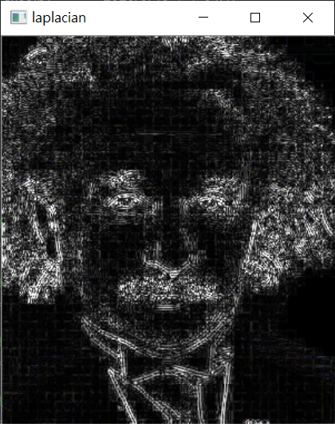
Laplacian Derivatives(ex09)
import cv2
import numpy as np
img = cv2.imread("blursample.jpg")
laplacian = cv2.Laplacian(img,cv2.CV_16S, ksize=3)
dst = cv2.convertScaleAbs(laplacian)
cv2.imshow("orign", img)
cv2.imshow('laplacian', dst)
cv2.waitKey()
cv2.destroyAllWindows()

Slide 24
Geometric Transformations of Images
Goals
Learn to apply different geometric transformation to images like translation, rotation, affine transformation etc.
You will see these functions: cv2.getPerspectiveTransform
Transformations
OpenCV provides two transformation functions
cv2.warpAffine takes a 2x3 transformation matrix
cv2.warpPerspective takes a 3x3 transformation matrix

Slide 25
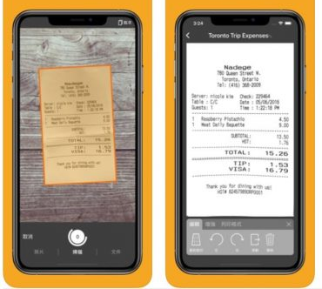

Slide 26
Affine and perspective transformations

Slide 27
Perspective and affi ne mapping of an image

Slide 28
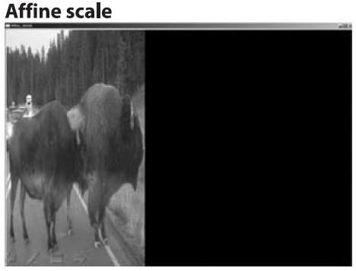
Perspective and affine mapping of an image

Slide 29
Geometric Transformations of Images
Scaling
Scaling is just resizing of the image.
OpenCV comes with a function cv2.resize() for this purpose.
The size of the image can be specified manually, or you can specify the scaling factor.
Different interpolation methods are used. P
referable interpolation methods are cv2.INTER_AREA for shrinking and cv2.INTER_CUBIC (slow) & cv2.INTER_LINEAR for zooming.
By default, interpolation method used is cv2.INTER_LINEAR for all resizing purposes. You can resize an input image either of following methods:

Slide 30
Affine and perspective transformations
Affine transforms can convert rectangles to parallelograms. They can squash the shape but must keep the sides parallel; they can rotate it and/or scale it.
Perspective transformations offer more flexibility; a perspective transform can turn a rectangle into a trapezoid.
For planar areas, there are two flavors of geometric transforms: transforms that use a 2-by-3 matrix, which are called affine transforms
transforms based on a 3-by-3 matrix, which are called perspective transforms or homographies.

Slide 31
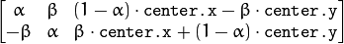
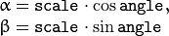
Rotate an Image
cv.GetRotationMatrix2D(center, angle, scale)
center – Center of the rotation in the source image.
angle – Rotation angle in degrees. Positive values mean counter-clockwise rotation (the coordinate origin is assumed to be the top-left corner).
scale – Isotropic scale factor.

Slide 32
cv2.warpAffine
cv2.warpAffine(src, M, dsize[, dst[, flags[, borderMode[, borderValue]]]])
src – input image.
dst – output image that has the size dsize and the same type as src .
M – 2*3 transformation matrix.
dsize – size of the output image.
flags – combination of interpolation methods.
borderMode – pixel extrapolation method.
borderValue – value used in case of a constant border; by default, it is 0.

Slide 33
shape attribute returns the height and width
img.shape
(Height, Width, Channel)
height, width = img.shape[0:2]
Return height & width

Slide 34
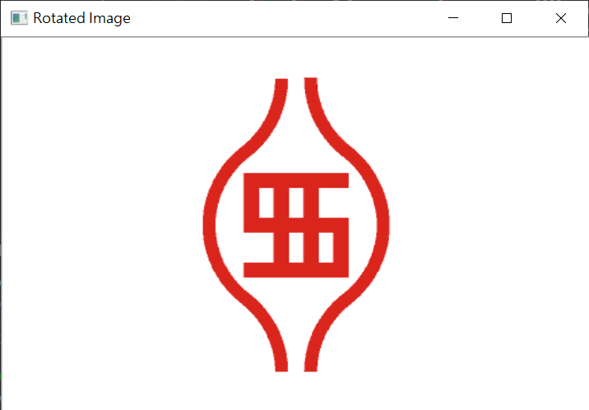
Rotate an Image (ex10)
import cv2
img = cv2.imread("mcut.png")
print(type(img))
height, width = img.shape[0:2]
print(img.shape)
print(height, width, img.shape[0:2])
cv2.imshow('Original Image', img)
#cv2.getRotationMatrix2D(center, angle, scale)
rotationMatrix = cv2.getRotationMatrix2D((width/2, height/2), 90, .5)
rotatedImage = cv2.warpAffine(img, rotationMatrix,
dsize=(width, height), borderValue=(255,255,255))
cv2.imshow('Rotated Image', rotatedImage)
cv2.waitKey()
cv2.destroyAllWindows()

Slide 35
interpolation methods
INTER_NEAREST – a nearest-neighbor interpolation
INTER_LINEAR – a bilinear interpolation (used by default)
INTER_AREA – resampling using pixel area relation. It may be a preferred method for image decimation, as it gives moire’-free results. But when the image is zoomed, it is similar to theINTER_NEAREST method.
INTER_CUBIC – a bicubic interpolation over 4×4 pixel neighborhood
INTER_LANCZOS4 – a Lanczos interpolation over 8×8 pixel neighborhood

Slide 36
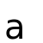
interpolation methods
cv2.INTER_AREA
cv2.INTER_CUBIC
default image
cv2.INTER_LANCZOS4
cv2.INTER_NEAREST
cv2.INTER_LINEAR

Slide 37
cv2.getAffineTransform(src, dst) → retval
3 points
cv2.getPerspectiveTransform(src, dst) → retval
4 points
cv2.getRectSubPix(image, patchSize, center[, patch[, patchType]]) → patch
cv2.getRotationMatrix2D(center, angle, scale) → retval

Slide 38
Affine transformations
It is easily seen that the effect of the affine transformation A · X + B is exactly equivalent to extending the vector X into the vector X´ and simply left -multiplying X´ by T.
Affine transformations can be visualized as follows. Any parallelogram ABCD in a plane can be mapped to any other parallelogram A'B'C'D' by some affine transformation.
If the areas of these parallelograms are nonzero, then the implied affine transformation is defined uniquely by (three vertices of) the two parallelograms.
If you like, you can think of an affine transformation as drawing your image into a big rubber sheet and then deforming the sheet by pushing or pulling* on the corners to make different kinds of parallelograms.

Slide 39
cv2.getAffineTransform(src, dst)
src – Coordinates of triangle vertices in the source image.
dst – Coordinates of the corresponding triangle vertices in the destination image.
Calculates the 2 * 3 matrix of an affine transform
Top left, Top right, Bottom left offset
P1
P1
P0
P0
P2
P2
Parallelogram

Slide 40
AffineTransform (ex11)
import cv2
import numpy as np
import matplotlib.pyplot as plt
img = cv2.imread("mcut.png")
height, width = img.shape[:2]
pts1 = np.float32([[0,0],[width,0],[0,height]])
pts2 = np.float32([[10,100],[300,50],[100,250]])
M = cv2.getAffineTransform(pts1,pts2)
Affine = cv2.warpAffine(img,M,(width,height))
cv2.imshow('Original Image', img)
cv2.imshow('Affine transformations', Affine)
cv2.waitKey()
cv2.destroyAllWindows()

Slide 41
Camera Model

Slide 42
A point Q = (X, Y, Z) is projected onto the image plane by the ray passing through the center of projection, and the resulting point on the image is q = (x, y, f )

Slide 43
Basic Projective Geometry
The relation that maps the points Qi in the physical world with coordinates (Xi, Yi, Zi) to the points on the projection screen with coordinates (xi, yi) is called a projective transform.
When working with such transforms, it is convenient to use what are known as homogeneous coordinates.
The homogeneous coordinates associated with a point in a projective space of dimension n are typically expressed as an (n + 1)-dimensional vector
(e.g., x, y, z becomes x, y, z, w), with the additional restriction that any two points whose
values are proportional are equivalent.

Slide 44
Th is allows us to arrange the parameters that define our camera (i.e., fx, fy, cx, and cy) into a single 3-by-3 matrix, which we will call the camera intrinsics matrix

Slide 45
Rotation Matrix and Translation Vector

Slide 46
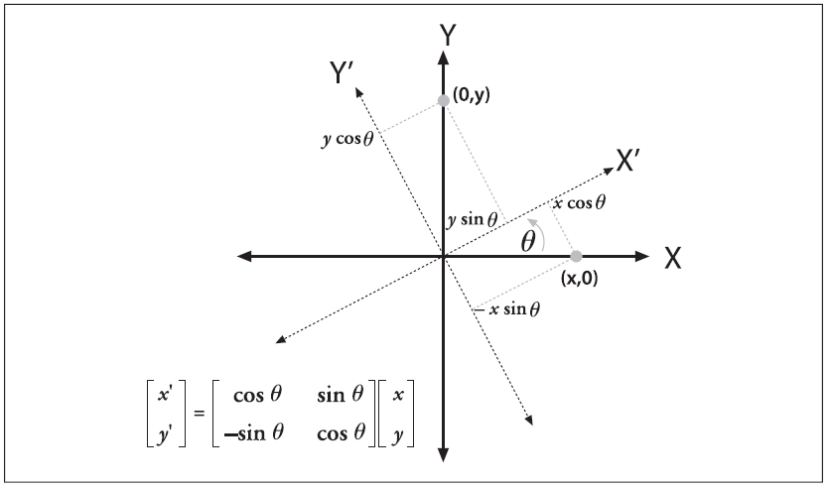
Rotation Matrix
total rotation matrix R

Slide 47
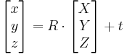
Translation Vector
The translation vector is how we represent a shift from one coordinate system to another system whose origin is displaced to another location;
the translation vector is just the offset from the origin of the first coordinate system to the origin of the second coordinate system.
Thus, to shift from a coordinate system centered on an object to one centered at the camera, the appropriate translation vector is simply T = originobject –origincamera. A point in the object (or world) coordinate frame Po has coordinates Pc in the camera coordinate frame:

Slide 48
warpPerspective
cv2.warpPerspective(src, M, dsize[, dst[, flags[, borderMode[, borderValue]]]]) → dst
src – input image.
dst – output image that has the size dsize and the same type as src .
M – 3 * 3 transformation matrix.
dsize – size of the output image.
Flags – interpolation methods
borderValue – value used in case of a constant border; by default, it equals 0.ransforms

Slide 49
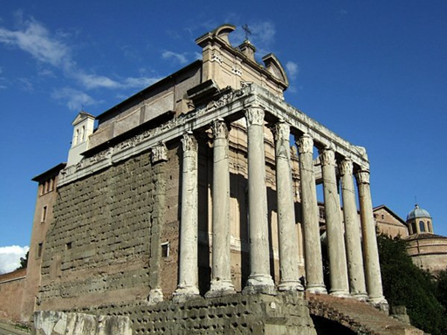
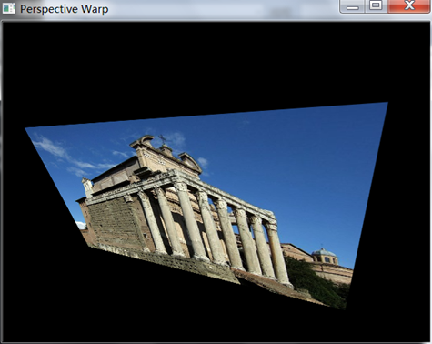
cv2.getPerspectiveTransform(src,dst)
src – Coordinates of triangle vertices in the source image.
dst – Coordinates of the corresponding triangle vertices in the destination image.
Calculates the 3 * 3 matrix of an Perspective transform
4 points
P1
P2
P2
P1
P3
P4
P3
P4

Slide 50
warpPerspective (ex12)
import cv2
import numpy as np
img = cv2.imread("mcut.png")
height, width = img.shape[:2]
pts1 = np.float32([[0,0],[width,0],[0,height],[width,height]])
pts2 = np.float32([[10,50],[500,0],[0,300],[400,280]])
M = cv2.getPerspectiveTransform(pts1,pts2)
Perspective = cv2.warpPerspective(img,M,(width,height))
cv2.imshow('Original Image', img)
cv2.imshow('Perspective transformations', Perspective)
cv2.waitKey()
cv2.destroyAllWindows()

Slide 51
Remap
cv2.remap(src, map1, map2, interpolation[, dst[, borderMode[, borderValue]]]) → dst
src – Source image.
dst – Destination image.
map1 – The first map of either (x,y) points or just x values having the type CV_16SC2 , CV_32FC1 , or CV_32FC2 . See convertMaps() for details on converting a floating point representation to fixed-point for speed.
map2 – The second map of y values having the type CV_16UC1 , CV_32FC1 , or none (empty map if map1 is (x,y) points), respectively.
interpolation
borderMode
borderValue

Slide 52
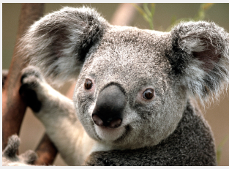
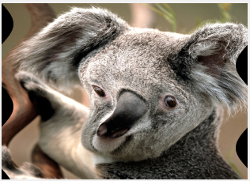
Remap
Use Remap to change graphics

Slide 53
Remap (ex13)
import cv2
import numpy as np
img = cv2.imread("mcut.png")
height, width = img.shape[:2]
map_x = np.ones( (height, width) , dtype=np.float32)
map_y = np.ones( (height, width) , dtype=np.float32)
for w in range(width):
for h in range(height):
map_x[h,w]= w-np.sin(h*np.pi/180)*100
map_y[h,w] = h
dst = cv2.remap(img, map_x, map_y, cv2.INTER_LINEAR)
cv2.imshow('Original Image', img)
cv2.imshow('remap Image', dst)
cv2.waitKey()
cv2.destroyAllWindows()

Slide 54

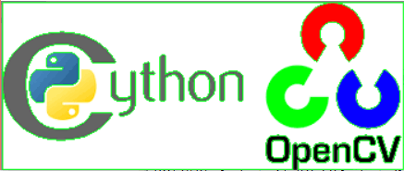
Get image contour
Contours are the curves in an image that are joint together. The curves join the continuous points in an image. The purpose of contours is used to detect the objects.

Slide 55
Get image contour (ex14)
import cv2
import numpy as np
img = cv2.imread("mcut.png")
img2=img.copy()
gray_img = cv2.cvtColor(img, cv2.COLOR_BGR2GRAY)
retval, thresh = cv2.threshold(gray_img, 127, 255, 0)
img_contours, _ = cv2.findContours(thresh, cv2.RETR_TREE, cv2.CHAIN_APPROX_SIMPLE)
cv2.drawContours(img2, img_contours, -1, (0, 255, 0))
cv2.imshow('Original Image', img)
cv2.imshow('Image Contours', img2)
cv2.waitKey()
cv2.destroyAllWindows()

Slide 56
What are contours?
Contours can be explained simply as a curve joining all the continuous points (along the boundary), having same color or intensity. The contours are a useful tool for shape analysis and object detection and recognition.
For better accuracy, use binary images. So before finding contours, apply threshold or canny edge detection.
In OpenCV, finding contours is like finding white object from black background. So remember, object to be found should be white and background should be black.

Slide 57
how to find contours of a binary image (ex15)
import cv2
import numpy as np
img = cv2.imread("mcut.png")
img2=img.copy()
gray_img = cv2.cvtColor(img, cv2.COLOR_BGR2GRAY)
retval, thresh = cv2.threshold(gray_img, 127, 255, 0)
img_contours, _ = cv2.findContours(thresh, cv2.RETR_TREE, cv2.CHAIN_APPROX_SIMPLE)
cnt=img_contours[3]
cv2.drawContours(img2, [cnt], 0, (0, 255, 0))
cv2.imshow('Original Image', img)
cv2.imshow('Image Contours', img2)
cv2.waitKey()
cv2.destroyAllWindows()

Slide 58
How to draw the contours?
To draw the contours, cv.drawContours function is used. It can also be used to draw any shape provided you have its boundary points. Its first argument is source image, second argument is the contours which should be passed as a Python list, third argument is index of contours (useful when drawing individual contour. To draw all contours, pass -1) and remaining arguments are color, thickness etc.
To draw all the contours in an image:
cv.drawContours(img, contours, -1, (0,255,0), 3)
To draw an individual contour, say 4th contour:
cv.drawContours(img, contours, 3, (0,255,0), 3)
But most of the time, below method will be useful:
cnt = contours[4]
cv.drawContours(img, [cnt], 0, (0,255,0), 3)

Slide 59
Contour Features
Moments
Contour Area
Contour Perimeter
Contour Approximation
Convex Hull
Checking Convexity
Bounding Rectangle
Straight Bounding Rectangle
Rotated Rectangle
Minimum Enclosing Circle
Fitting an Ellipse
Fitting a Line

Slide 60
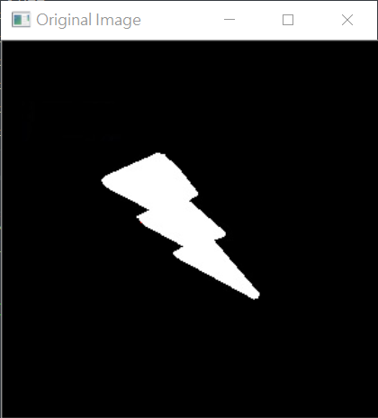
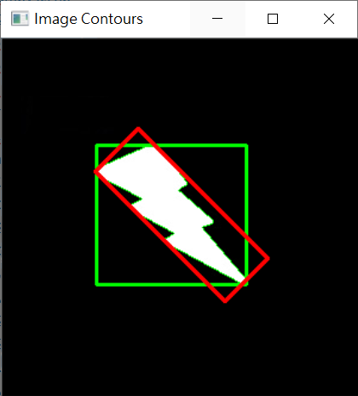
Contour Features (ex16)
import cv2
import numpy as np
img = cv2.imread("boundingrect.png")
img2=img.copy()
img3=img.copy()
gray_img = cv2.cvtColor(img, cv2.COLOR_BGR2GRAY)
retval, thresh = cv2.threshold(gray_img, 127, 255, 0)
contours,hierarchy = cv2.findContours(thresh, 1, 2)
cnt = contours[0]
area = cv2.contourArea(cnt)
cv2.drawContours(img2, [cnt], 0, (0, 255, 0))
hull = cv2.convexHull(cnt)
cv2.drawContours(img2, [cnt], 0, (0, 255, 0))
x,y,w,h = cv2.boundingRect(cnt)
img2 = cv2.rectangle(img2,(x,y),(x+w,y+h),(0,255,0),2)
rect = cv2.minAreaRect(cnt)
box = cv2.boxPoints(rect)
box = np.int0(box)
img2 = cv2.drawContours(img2,[box],0,(0,0,255),2)
cv2.imshow('Original Image', img)
cv2.imshow('Image Contours', img2)
cv2.waitKey()
cv2.destroyAllWindows()
Image moments help you to calculate some features like center of mass of the object, area of the object etc. Check out the wikipedia page on Image Moments

